Slide 1
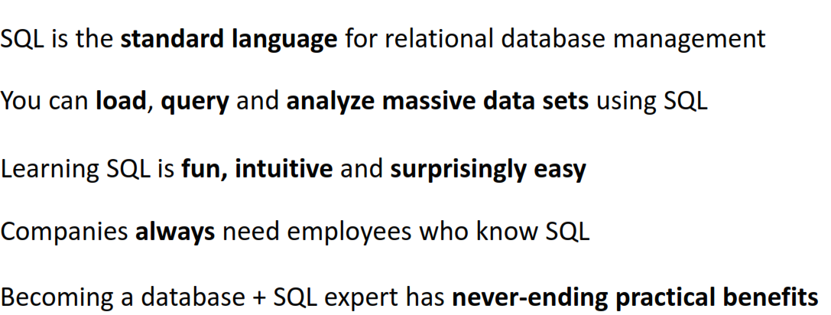
SQL

Slide 2
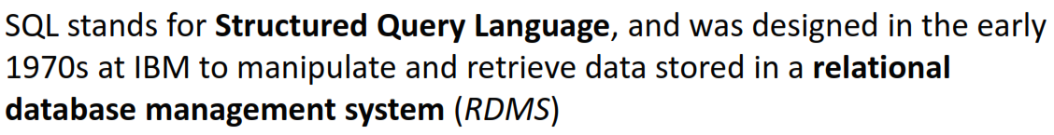

SQL

Slide 3
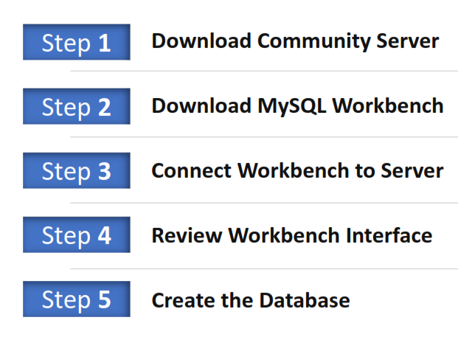
MySQL DOWNLOAD & SETUP – OVERVIEW
https://dev.mysql.com/downloads/

Slide 4
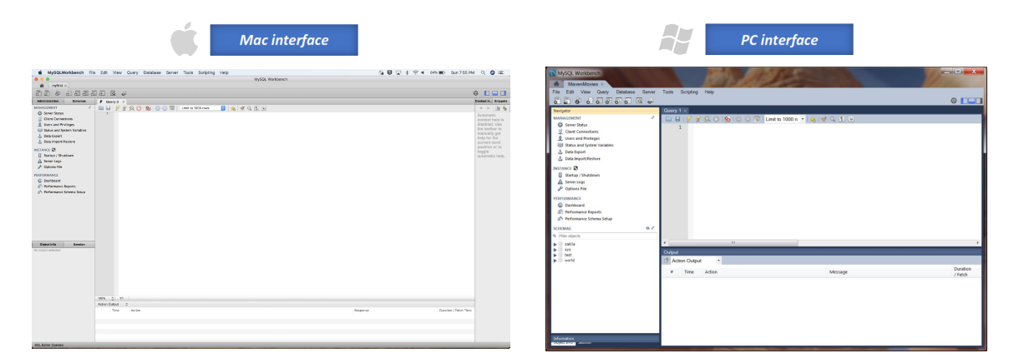

Slide 5
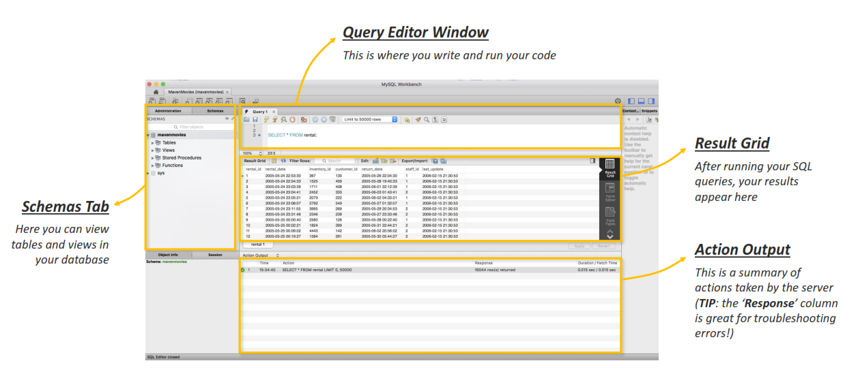

Slide 6
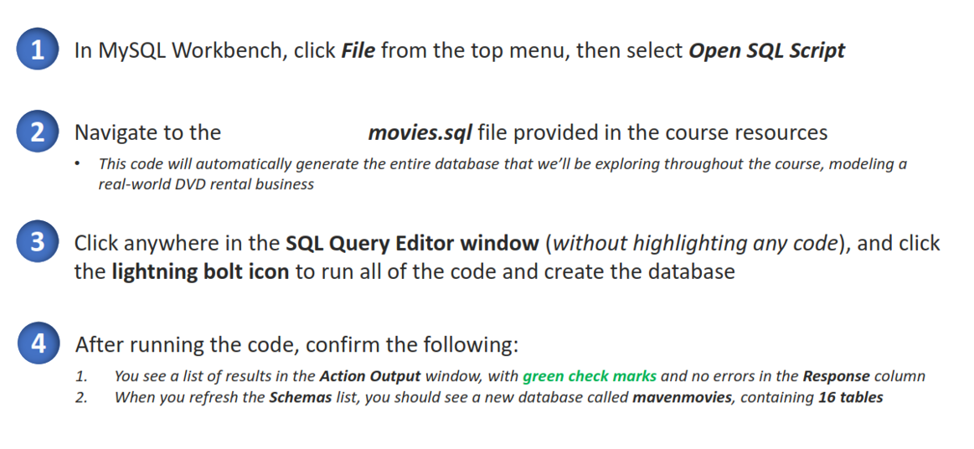
CREATING THE DATABASE

Slide 7
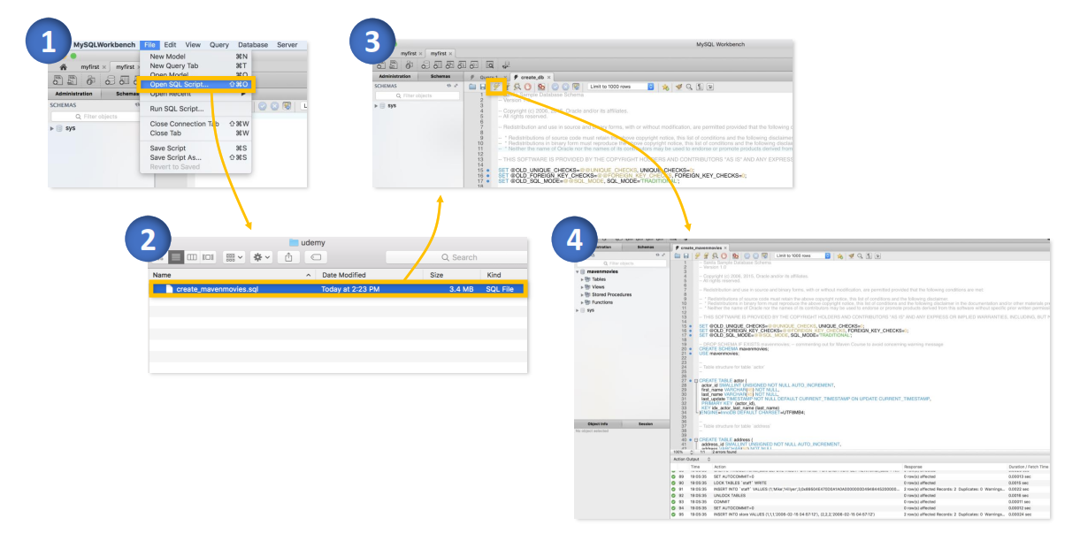

Slide 8
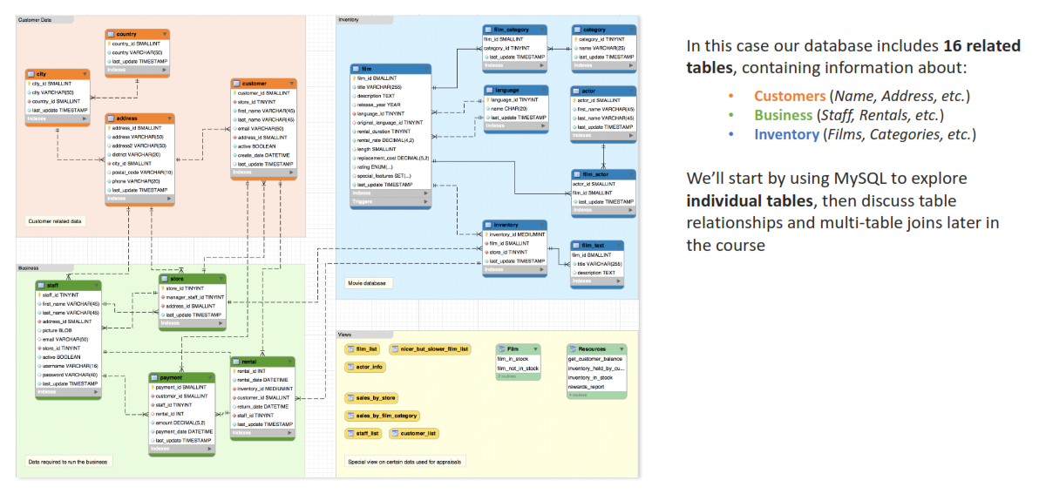
A DATABASE CAN CONTAIN MANY RELATED TABLES

Slide 9
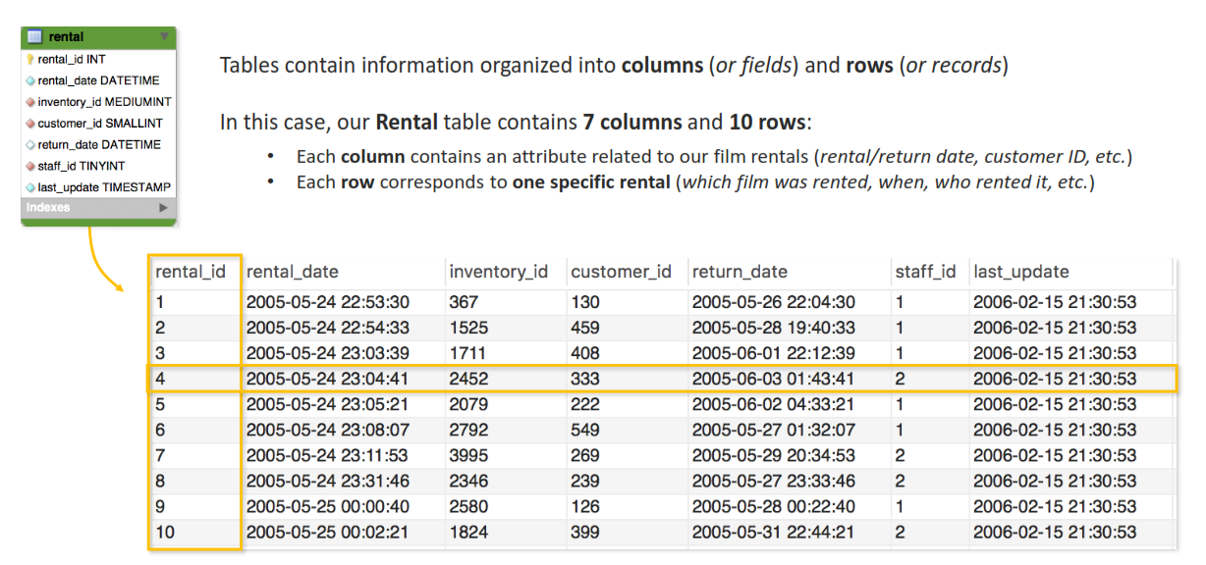
SQL

Slide 10
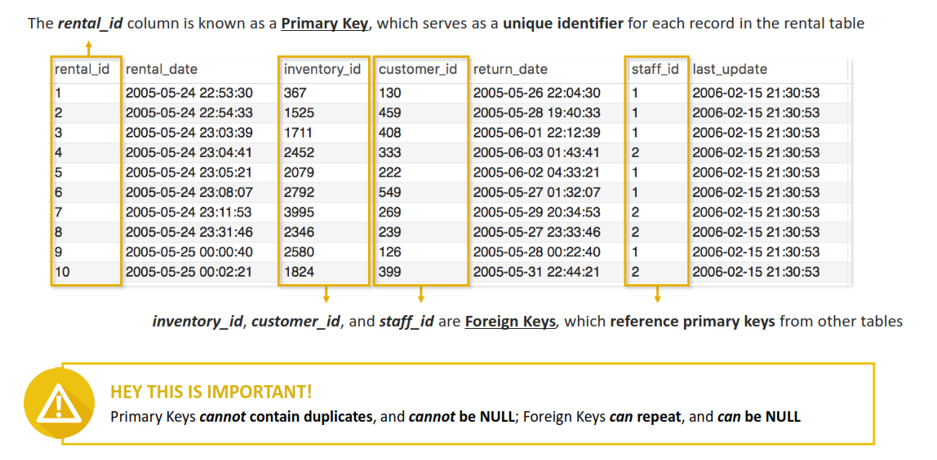
TABLES CAN CONTAIN PRIMARY & FOREIGN KEYS

Slide 11
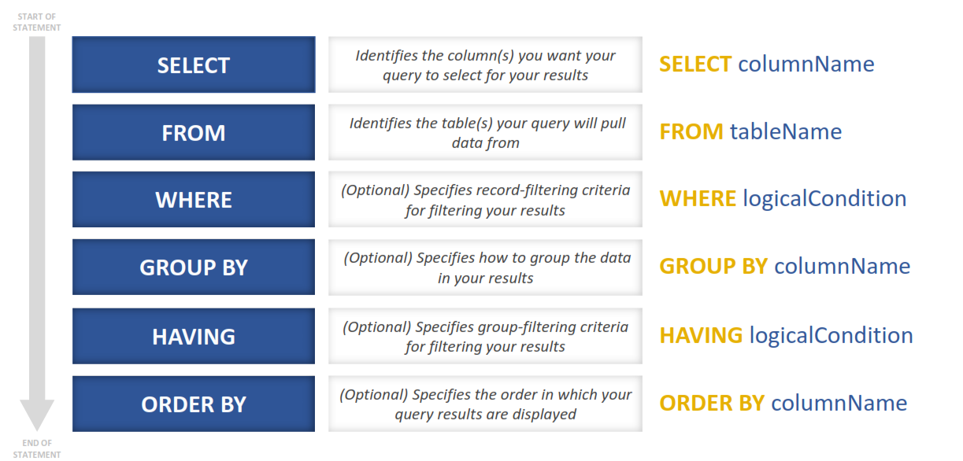
THE “BIG 6” ELEMENTS OF A SQL SELECT STATEMENT

Slide 12
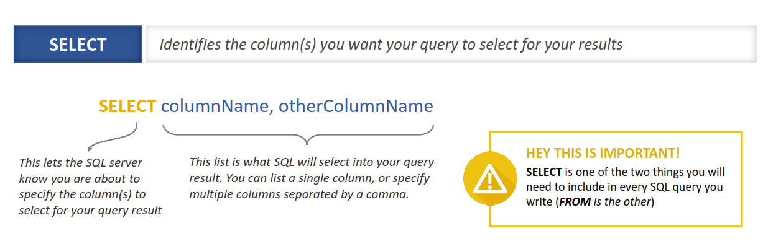
THE SELECT STATEMENT

Slide 13
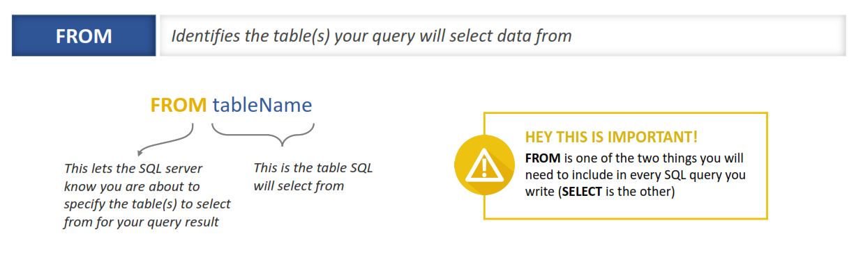
THE FROM CLAUSE

Slide 14
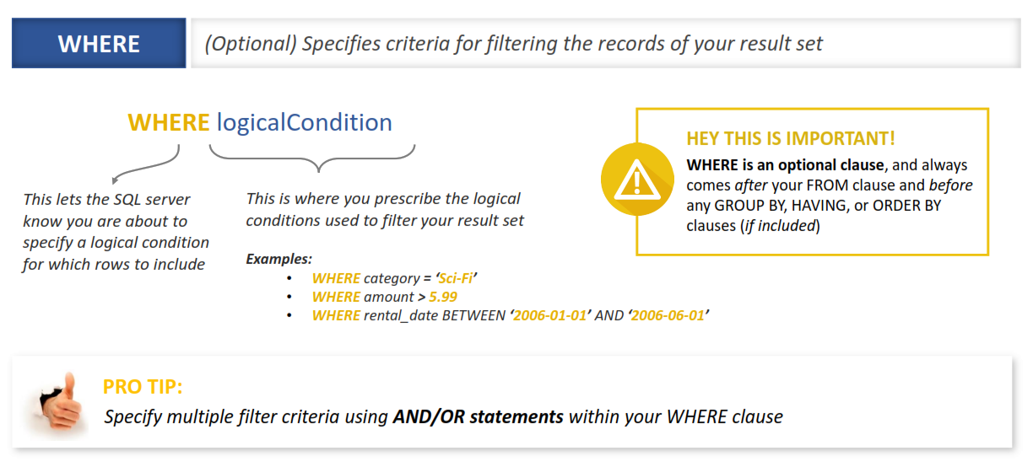
THE WHERE CLAUSE

Slide 15
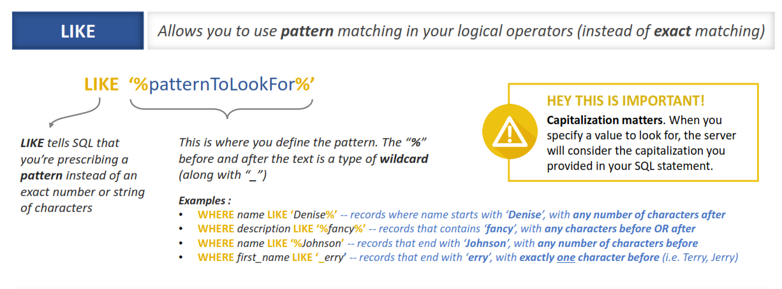
THE LIKE OPERATOR

Slide 16
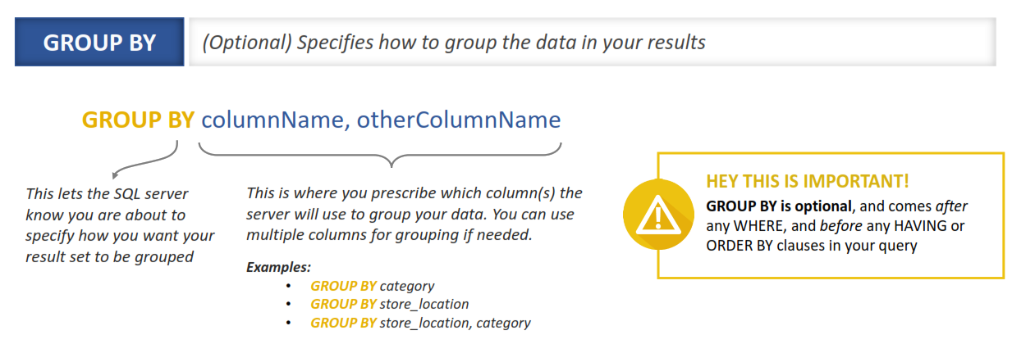
THE GROUP BY CLAUSE

Slide 17
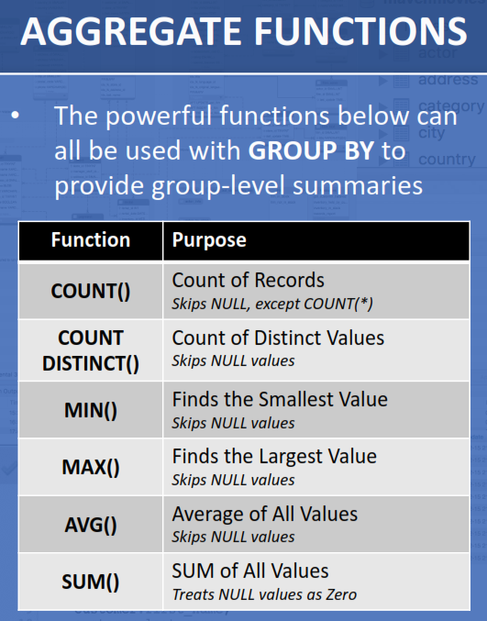
AGGREGATE FUNCTIONS

Slide 18
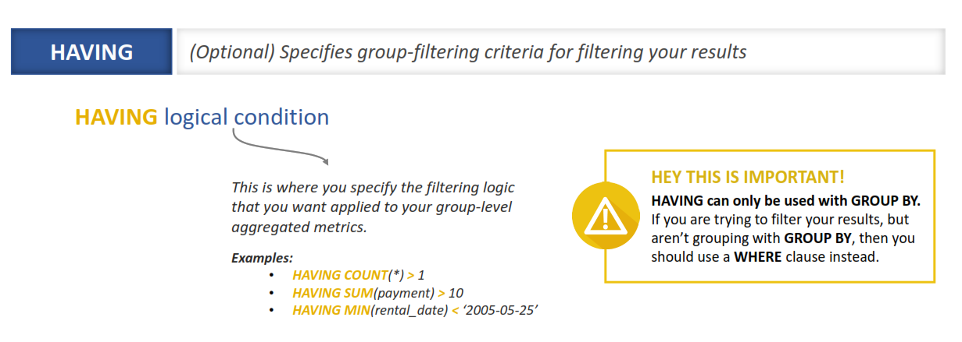
THE HAVING CLAUSE

Slide 19
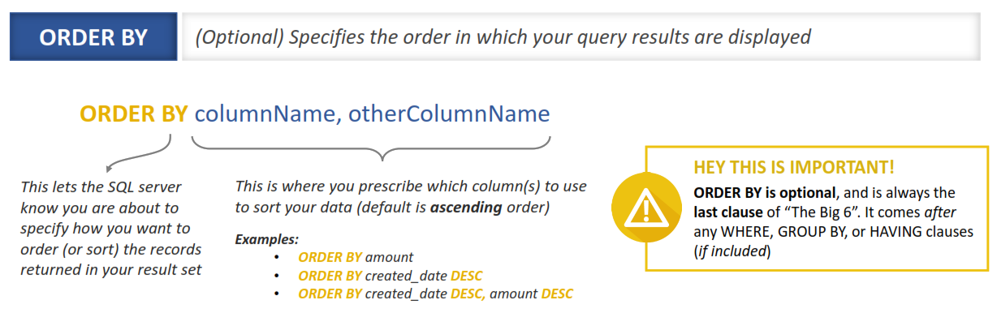
THE ORDER BY CLAUSE

Slide 20
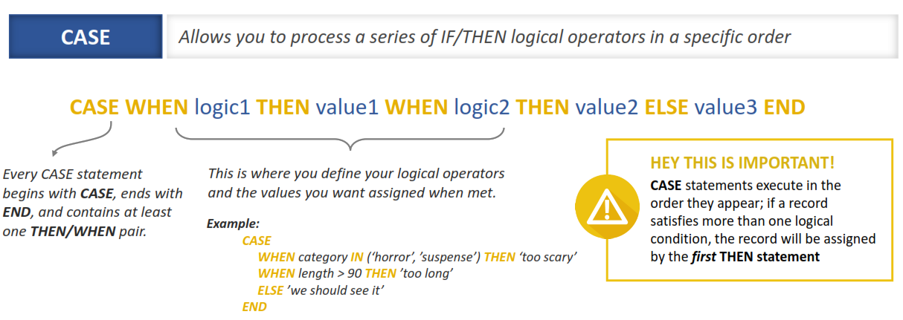
THE CASE STATEMENT

Slide 21
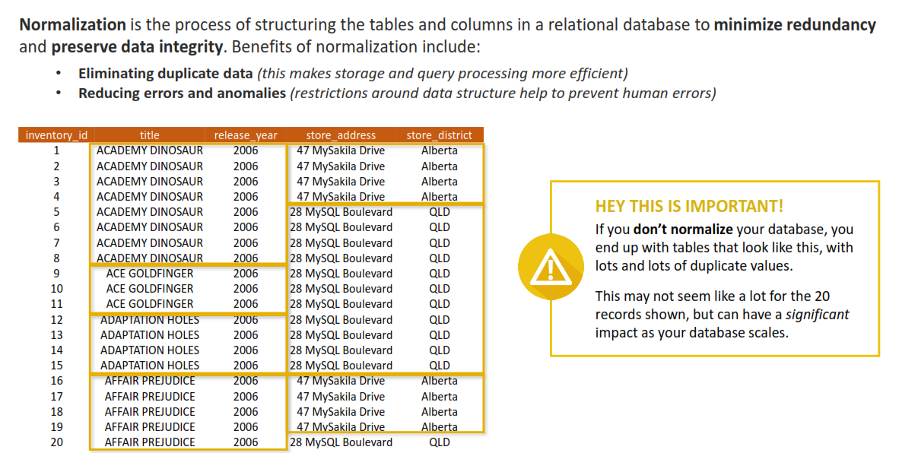
DATABASE NORMALIZATION

Slide 22
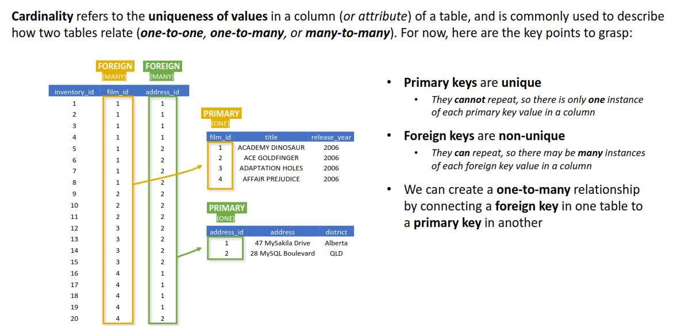
TABLE RELATIONSHIPS & CARDINALITY

Slide 23
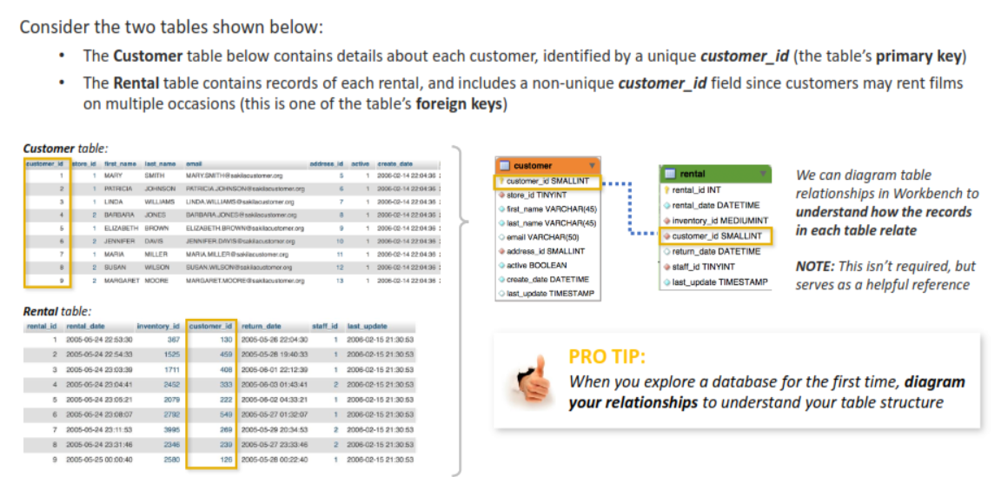
Relationship Diagrams

Slide 24
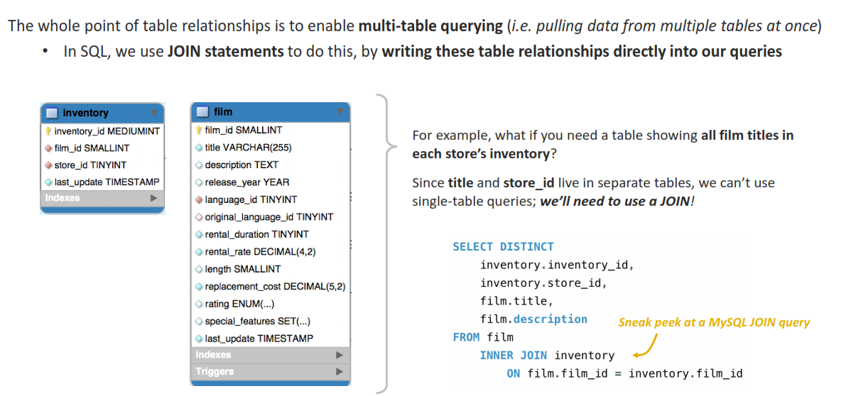
USING JOINS FOR MULTI-TABLE QUERYING

Slide 25
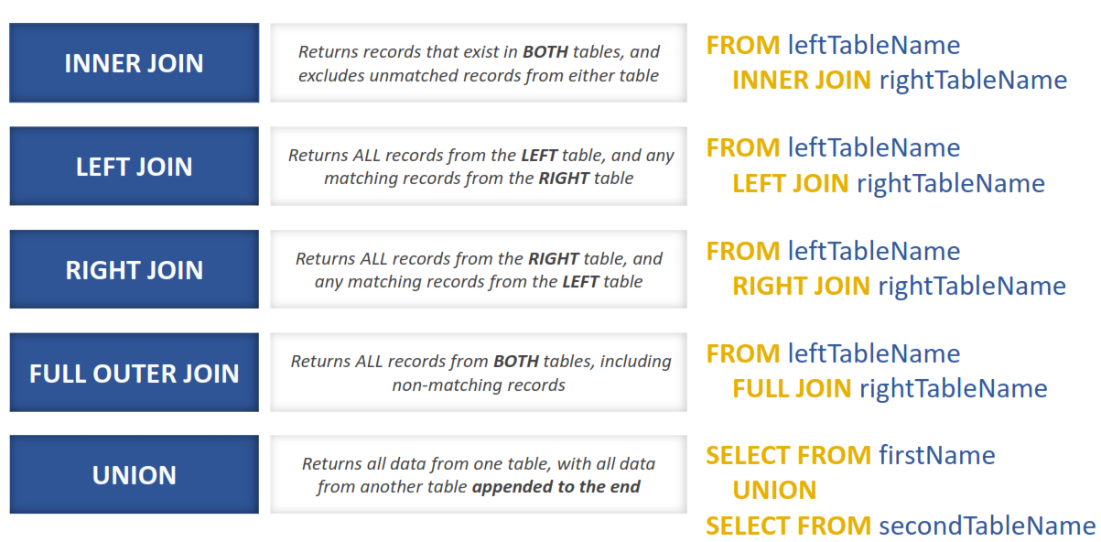
COMMON JOIN TYPES

Slide 26
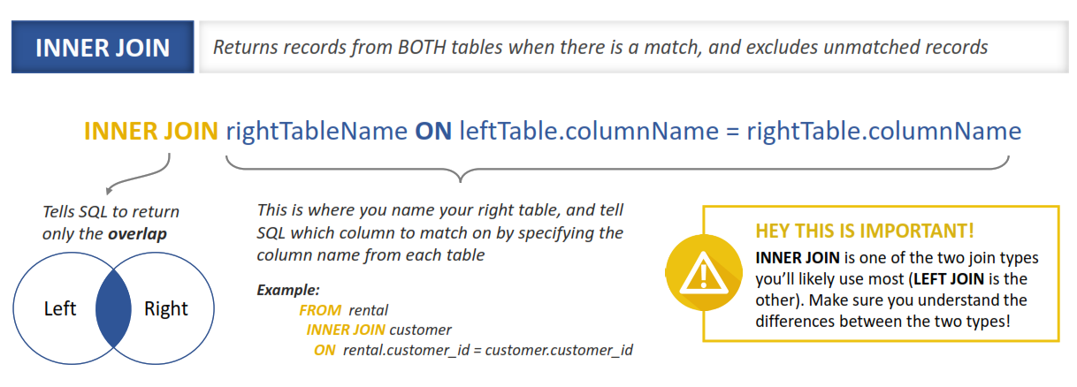
INNER JOIN

Slide 27
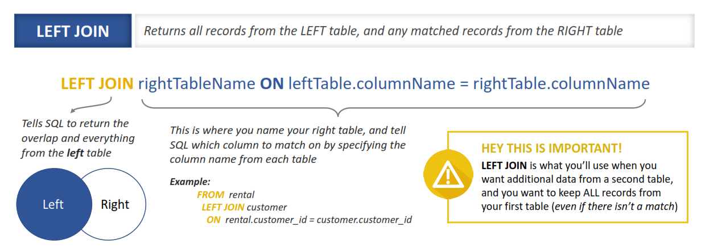
LEFT JOIN

Slide 28
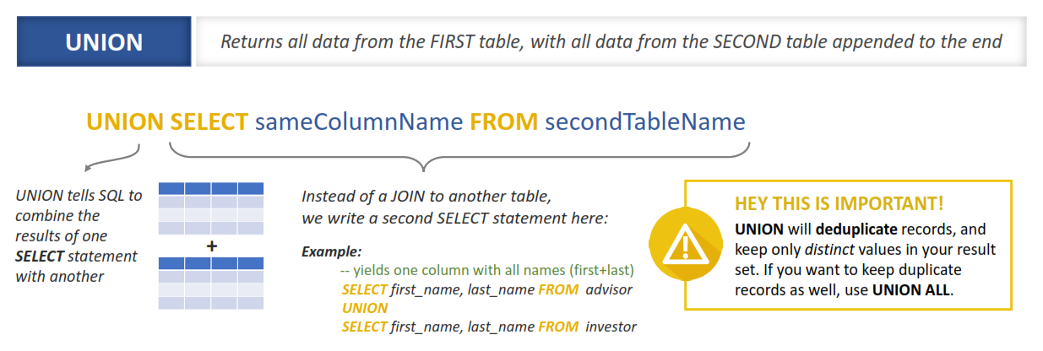
UNION: A DIFFERENT WAY TO COMBINE TABLES

